Slide 1


“Breast Cancer Prediction” using Machine Learning models
Submitted By:
Group 22
Deep Singh (251122489)
Mandeep Singh (251122474)
Sanket Salunke (251102392)

Slide 2
Introduction
It is the second leading cause of death among women.
It accounts for 13 to 25% death among Canadian women.
In some of the developing countries the issue is far worst and mortality rate to more than 80% of total deaths due to cancer.
Its estimated that in year 2019 only, around 30,000 cases were diagnosed with breast cancer and 5000 severe cases
Essentially cancer is not a disease but a group of disease, which cause an abnormal growth of body cells which can become malign cells, also termed as cancerous cells.

Slide 3
Problem Statement
The early diagnosis of Breast cancer can significantly increase the chance of survival
Presently there are many models, which can be used for predictions but their accuracy is relatively low.
Our goal with this project is to access ML models and detect the cancerous cells with a higher degree of accuracy.

Slide 4
Contents
Methodology
Dataset Description
Exploratory Data Analysis
Target Value Analysis
Feature Selection
Modelling
Random Forest
KNN
SVM
Model Evaluation
Results and Discussion

Slide 5
Methodology
1. Understanding Business Problem
2. Problem Formaliztion
3. Requirement Analysis
Data Collection (Acquiring Dataset)
4. Exploratory Data Analysis
To identify trends and features available in data
5. Data Preprocessing
Data Cleaning/Fixing missing values
6. Model Implentation
Splitting Data into train and test sets
8. Models Evaluation
What is to be predicted
What is Cancer
To build a ML model to predict Breast Cancer
Identifying appropriate models for problem
Model optimization
Data Normalization
Selecting best model (based on Accuracy Score on Test Data)
7. Results
9. Observation
Model scores and table
Methodolgy

Slide 6
Dataset Description
The dataset chosen to address this problem is obtained from Kaggle repository under the heading of Breast Cancer Wisconsin (Diagnostic) Data Set.
The dataset is owned by University of Wisconsin, available to students and researchers under open source license. There are 32 features in data set, including
remaining features are based on real-valued features from images of cell nucleus, for example:
 | Feature Name | Feature Description
 | ID number
 | Diagnosis | M = Malign B = Benign
 | Radius | mean of distances from center to points on the perimeter
 | Texture | standard deviation of gray-scale values
 | Perimeter
 | Area
 | Smoothness | local variation in radius lengths
 | Compactness | perimeter^2 / area - 1.0
 | Concavity | severity of concave portions of the contour
 | Concave points | number of concave portions of the contour
 | Symmetry
 | Fractal Dimension | "coastline approximation" - 1

Slide 7
Exploratory Data Analysis
In order to summarize main characteristics of dataset EDA techniques are used. During the initial data analysis certain parameters were interrogated, viz.
Presence of Outliers
Presence of non-normal
Association between features
Pattern in data sets.
For this several analysis techniques/tools are employed, viz. Box Plot, Histogram and Scatterplot

Slide 8
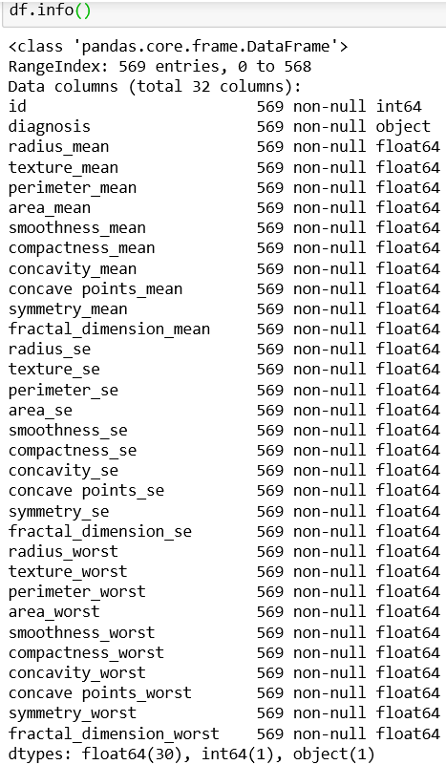
EDA Cont’d
Dataset comprises of 569 observations and 32 features
All data are in float format except for ‘id’ which is in integer format
No variable column has missing value

Slide 9
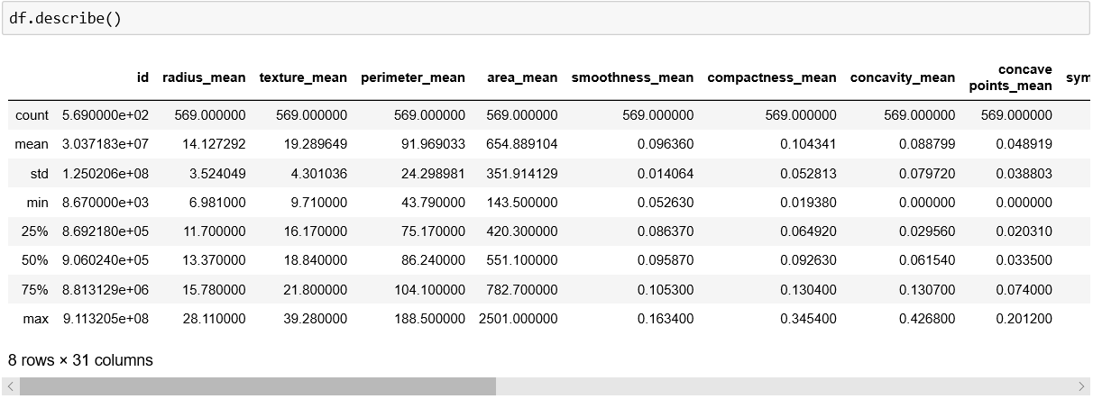
EDA Cont’d
Mean value for all features is greater than median value (50%)
Noticeable difference between 75% and max value for all features, this indicates presence of outliers in data set.

Slide 10
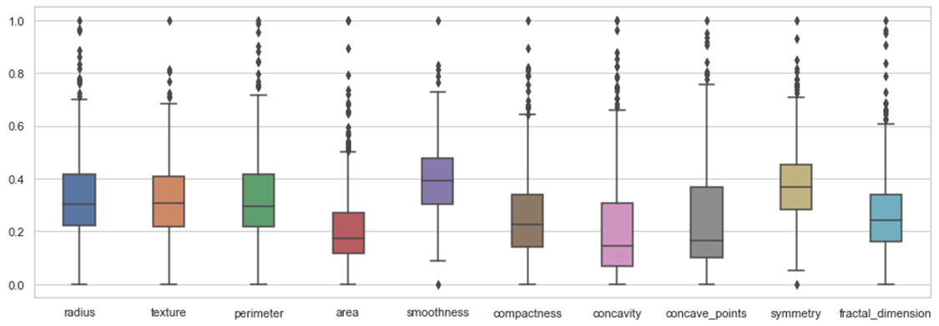
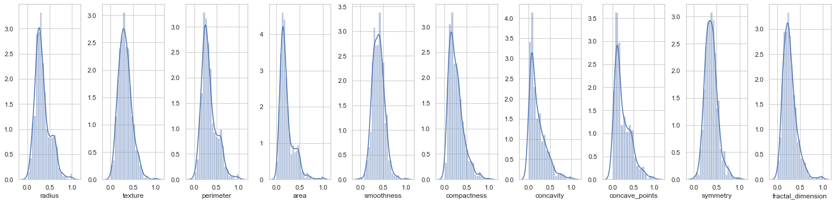
EDA Cont’d
Presence of outliers is in 4th quadrant, and rarely in 3rd and 1st as in case of smoothness and symmetry
Texture, smoothness and symmetry are normally distributed
Remaining variables are skewed

Slide 11
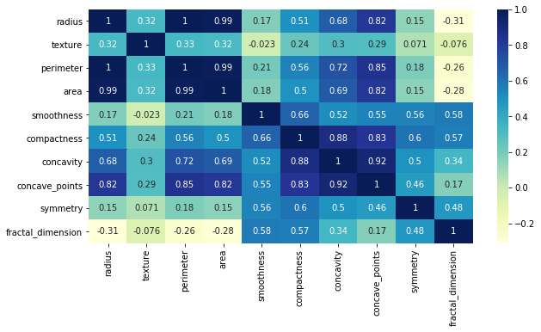
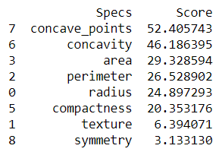
Feature Selection
Feature Ranking is done selectkbest method, concavity and concave_points are most important features

Slide 12
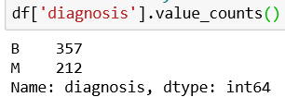
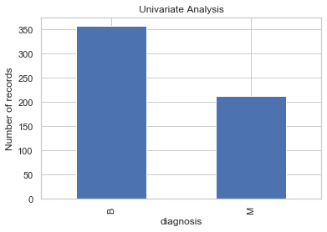
Target Value Analysis
Target/dependent feature is categorical in nature with two possible outcomes
With 357 Benign and 212 Malign outcomes
Dataset has 60 to 40 ratio for outcomes, which is a balanced ratio.

Slide 13
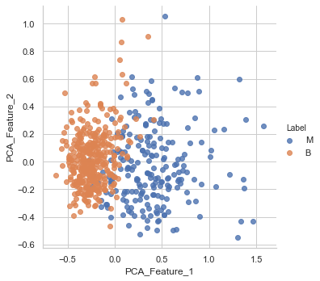
Principal Component Analysis

Slide 14
Modelling
KNN
Random Forest
SVM

Slide 15
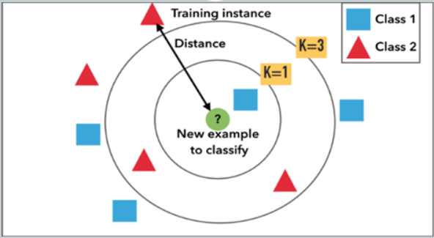
KNN Classifier
KNN Algorithm is based on feature similarity
KNN can be used for classification
Choose the right value of k in simple terms is very important

Slide 16
KNN Classifier (Cont’d)
Implemented a KNN model by following the below steps:
Loaded the data and divided in training and testing set
Changed categorical values of diagnosis to 1 for malignant and 0 for benign
Initialize the value of k
For getting the value of k, iterate from 1 to 50 with step size of 2
Calculate the accuracy, score and confusion matrix for each value of k
Using cross_val_score method to cross validate k value with different folding values

Slide 17
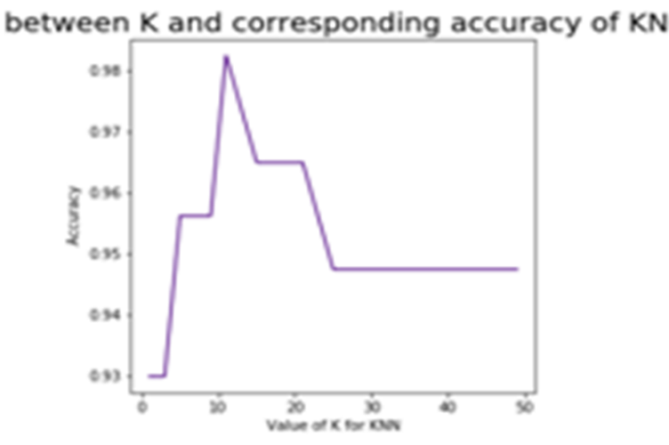
KNN Classifier (Cont’d)
We can see the accuracy changes for different value of k
It will help to optimize the value of k to best fit our dataset

Slide 18
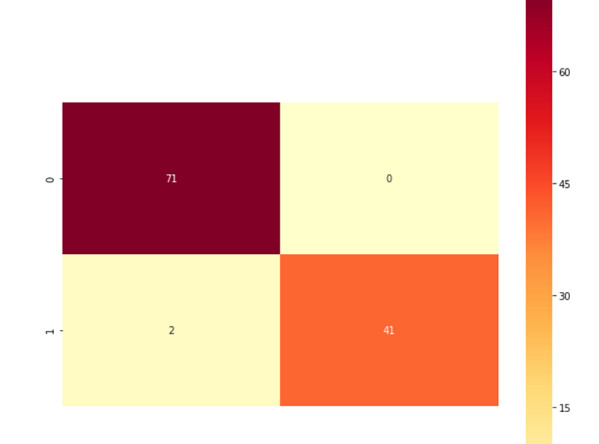
KNN Classifier (Cont’d)
Confusion matrix for KNN

Slide 19
KNN Classifier (Cont’d)
KNN accuracy is 0.9824561403508771
Accuracy = (True_Positive + True_Negative) / (True_Positive + True_Negative + False_Positive + False_Negative)
Precision is 1.0
Precision=True_Positive / (True_Positive + False_Positive)

Slide 20
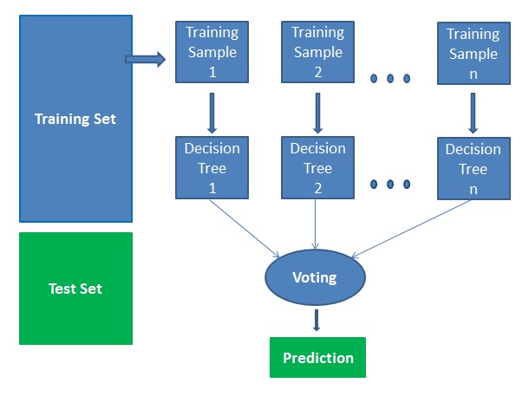
Random Forest
Supervised Learning Algorithm
Can be used for classification and regression

Slide 21
Random Forest (Cont’d)
How Random Forest works
Select random samples from a given dataset.
Construct a decision tree for each sample and get a prediction result from each decision tree.
Perform a vote for each predicted result.
Select the prediction result with the most votes as the final prediction.

Slide 22
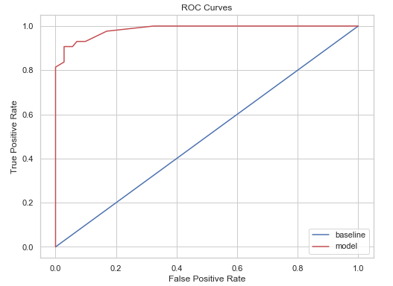
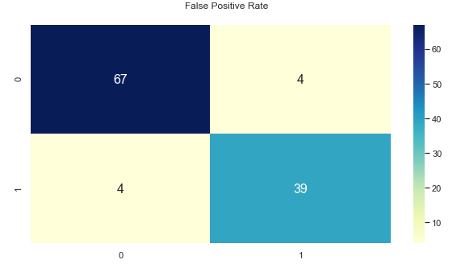
Random Forest (Cont’d)
Algorithm tested for multiple number of tree nodes ranging from 1 to 100.
Minimum Accuracy: 0.9298245614035088 is for 10 tree nodes
Maximum Accuracy: 0.9649122807017544 is for 15 tree nodes

Slide 23
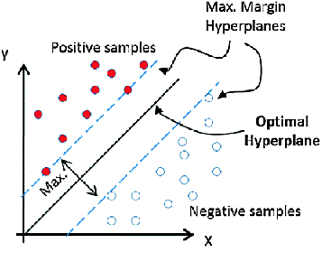
SVM Classifier
A type of supervised machine learning classification algorithm.
Constructs a hyperplane or set of hyperplanes in a high- or infinite-dimensional space, which can be used for classification, regression, or other tasks like outliers detection.
Which kernel will be best suited for the problem?

Slide 24
SVM Classifier (Cont’d)
Implemented a SVM model by following the below steps:
Loaded the data and divided in training and testing set.
Changed categorical values of diagnosis to 1 for malignant and 0 for benignant.
Trained the model using different three kernels i.e. Linear, Polynomial and Gaussian.
Calculated the accuracy, score, classification_report and confusion matrix for each kernel.
Used cross_val_score method using 5 folds.

Slide 25
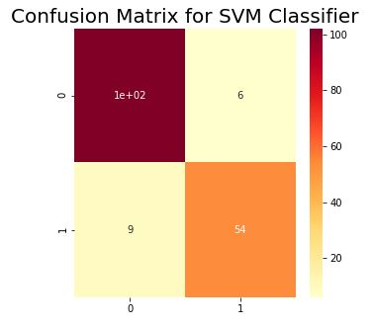
SVM Classifier (Cont’d)
Linear Kernel
Accuracy = 0.9415204678362573
Root Mean Squared Error = 0.2418254167033372
Root Mean Squared Error for ‘Cross Validation’ = 0.3130596254931703

Slide 26
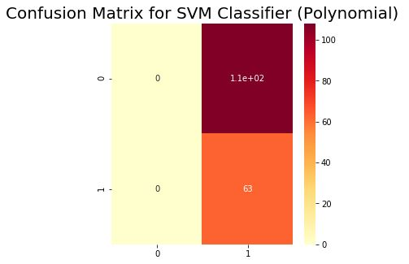
SVM Classifier (Cont’d)
Polynomial Kernel
Accuracy = 0.6666666666666666
Root Mean Squared Error = 0.5773502691896257
Root Mean Squared Error for ‘Cross Validation’ = 0.6576473218982952

Slide 27
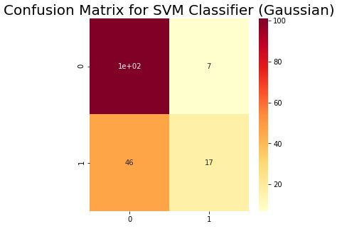
SVM Classifier (Cont’d)
Gaussian Kernel
Accuracy = 0.7017543859649122
Root Mean Squared Error = 0.5461186812727502
Root Mean Squared Error for ‘Cross Validation’ = 0.5695045592776011

Slide 28
SVM Classifier (Cont’d)
Comparing Linear, Polynomial and Gaussian Kernels
 | Linear | Polynomial | Gaussian
Accuracy | 0.9415204678362573 | 0.6666666666666666 | 0.7017543859649122
RMSE | 0.2418254167033372 | 0.5773502691896257 | 0.5461186812727502
RMSE for Cross Validation | 0.3130596254931703 | 0.6576473218982952 | 0.5695045592776011

Slide 29
Model Evaluation
Comparing different models to figure out the best fitting model
Model | Accuracy | CM
KNN | 0.9824561403508771 | [[71 0] [ 2 41]]
SVM (Linear) | 0.9415204678362573 | [[71 0] [ 4 39]]
SVM (Polynomial) | 0.6666666666666666 | [[65 6 ] [ 4 39]]
SVM (Gaussian) | 0.7017543859649122 | [[71 0] [ 3 40]]
Random Forest | 0.9649122807017544 | [[67 4] [ 3 40]]

Slide 30
Results And Discussion
After comparing three different model it can be conclude that KNN performs better other two model
KNN achieves highest accuracy of 0.9824561403508771
Therefore KNN classifier is more suitable for the given dataset

Slide 31
Thank You!

